Slide 1

TEAM 9

Slide 2
THE ORGANIZATION
CHOICES is an interactive decision-making workshop that empowers teens to achieve academic success in pursuit of their career and life aspirations.
In two hour-long sessions, business and community volunteers take students through real-world exercises on academic self-discipline, time and money management, and goal setting.

Slide 3
THE APP
We followed an agile software development life cycle model
First we defined our minimal viable product then we broke the process into several scrum sessions.
To build our app we used Android Studio, leveraging the accessible and easy to learn IDE.
Some scrum sessions were over in as little as 30 minutes, others went for hours.
Once the Minimum Viable Product was reached we focused on developing a more inviting interface with natural interactions

Slide 4
To create more interactive scenarios that encouraged critical thinking from the students and built positive rapport between the character and the student:
Emphasized the importance of the student's decisions on the characters academics, social and future opportunities.
Made scenarios span actual conversations creating a natural flow that draws in the user.
Students are rewarded for making good choices with trophies that increase their skills socially, academically, and introduce new opportunities for the characters.
Ultimately the character should with the help of participating students graduate.

Slide 5
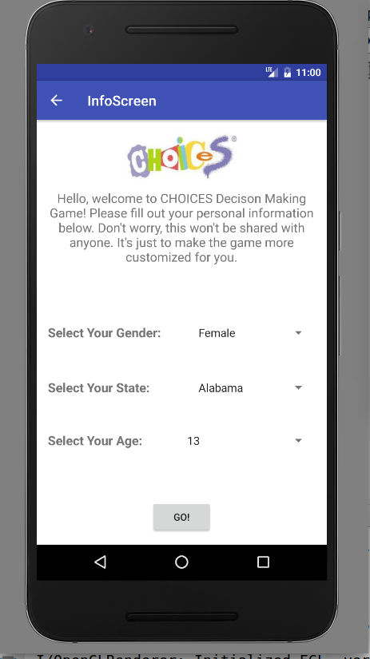
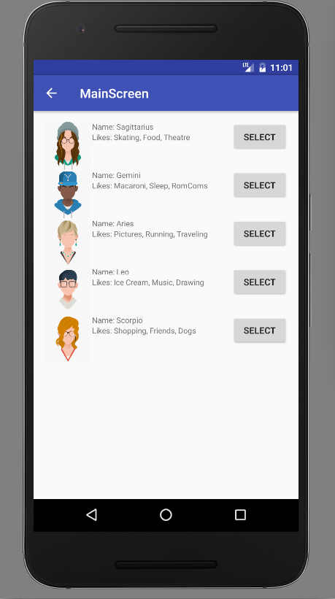
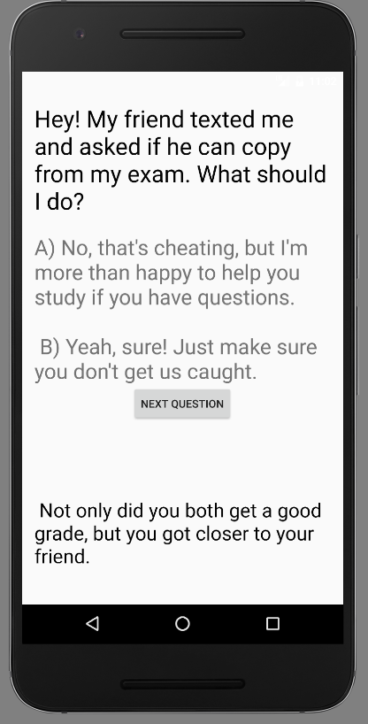

Slide 6
MOVING FORWARD
Students are given the opportunity to walk through more scenarios with a variety of characters after the daily scenarios.
Past decisions will reflect on future scenarios and interactions. Character decisions will impact their interactions with others in their school.
The setup currently would allow for new scenarios to be added by the CHOICES program team using a set template.

